Slide 1
Psychological Disorders
What is Abnormality?

Slide 2
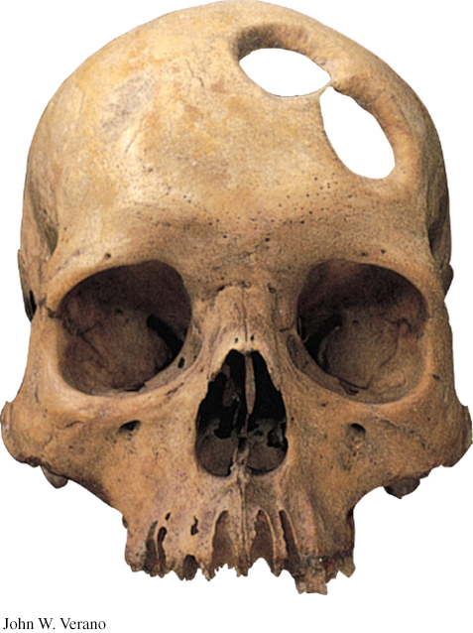
Hx of Abnormal Behavior
Trephining
Holes in head to release evil spirits
Imbalance in Body’s 4 humors
Hippocrates
1st to explain abnormal bx to biological causes
Witches
Middle Ages

Slide 3
Defining Abnormal Behavior
Statistical Definition
Frequency of Bx
Social Norm Deviance
Subjective Discomfort
Emotional distress
Maladaptive
Inability to function
Danger to Self or others

Slide 4
Maybe Everyone is Abnormal?
Abnormal Bx is surprisingly common
Song stuck in head, checking, counting
We do not think of someone as having a Psychological D/O unless 2 of the 5 criteria are met

Slide 5
What Causes Psychological D/O?
Biological Model
Physical cause for bx/thoughts/feelings
Biopsychosocial
Interaction of biological, psychological, and social-cultural envir helps form bx, thoughts, and feelings
Epigenetics: Study of envir influences on gene expressions that occur w/o DNA change

Slide 6
DSM-5 (2013)
LO 12.3 Types of psychological disorders
Diagnostic & Statistical Manual
Disorder and the symptoms
Describes typical course of illness
New edition- 20 categories
DOES NOT Indicate Treatment or Cause

Slide 7
The Pros and Cons of Labels
LO 12.3 Types of psychological disorders
Common language in the mental health field
Leads to treatment
Labels can bias judgment
In Children…. What are the pros & cons of a ‘label?’

Slide 8
Anxiety D/O’s
Most people have some level of anxiety
Excessive or Unrealistic Anxiety
Anxiety may be ‘specific’ or ‘general’
Free Floating Anxiety-Unrelated to any realistic or known factor

Slide 9
Types of Anxiety Disorders
Phobic Disorders
Persistent, irrational fear and avoidance of a specific: Object, Activity, Situation
Social Anxiety D/O
Social Phobia(DSM-IV)
Panic Disorder
Panic Attacks
Generalized Anxiety D/O

Slide 10
Causes of Anxiety Disorders
LO 12.4 Types and symptoms of anxiety disorders
Cognitive psychologists
Illogical, irrational thought processes
Magnification
Making mountains out of mole hills
All-or-Nothing Thinking
Accepts only perfection, or else they fail
Overgeneralization
Jumping to Conclusions
Minimization
Give no importance to one’s successes

Slide 11
Obsessive-Compulsive & Related Disorders
Obsessions
Thoughts
Compulsions
Behavior to relieve anxiety provoking thoughts
Related Disorders:
Body Dysmorphic D/O, Hoarding, Trichotillomania (hair-pulling), Excoriation (skin-picking)

Slide 12
Stress Related Disorders
LO 12.4 Types and symptoms of anxiety disorders
Post-traumatic Stress D/O (PTSD)
Haunting memories
Nightmares
Social Withdrawal
Jumpy Anxiety
Numbness of feelings
Insomnia that lingers for four weeks or more

Slide 13
PTSD Victims
Victims include survivors of accidents, disasters, violent &/or sexual assaults
Everyone experiences a traumatic event.
Some display survivor resiliency.
Others experience posttraumatic growth.
Higher the distress, the greater the risk of posttraumatic symptoms.

Slide 14
Factors Influencing PTSD Development after Trauma
Sensitive emotion-processing limbic system floods body w/ stress hormones.
Gender
Women -twice as likely as men to develop symptoms of PTSD.
Criticism
PTSD has been overdiagnosed to include normal stress-related bad memories and dreams.

Slide 15
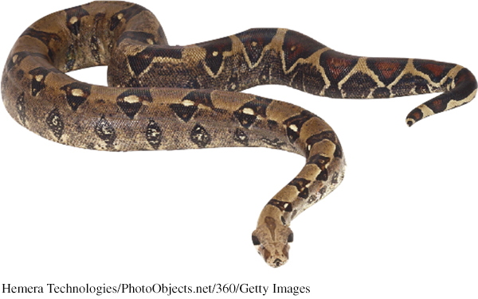
Understanding Anxiety D/Os, OCD, and PTSD
Anxiety is both a feeling and a thought.
Perspectives that help interpret anxiety:
Conditioning (Behavioral)
Cognition (Distorted thinking patterns)
Biology

Slide 16
Stress Related Disorders
LO 12.4 Types and symptoms of anxiety disorders
Acute Stress Disorder (ASD)
Symptoms occur w/in 4 wks of event
Include similar symptoms of PTSD

Slide 17
Psychoactive Drugs
Alters thinking, perception, mood or a combination of these
Physical Dependence
Inc in tolerance
Withdrawal symptoms appear when not using it
Psychological Dependence
Need drug to cont feeling of emotional well being
Any drug can cause this

Slide 18
Psychoactive Drugs
Stimulants: Increase mental & physical activity
Ex: Caffeine, meth, speed, cocaine, nicotine
Depressants: Decrease mental & physical activity
Ex: Alcohol, barbiturates (sedatives), benzodiazapines (anti-anxiety), Opiates
Hallucinogens: produces false sensations/perception
Ex: Marijuana, LSD, mushrooms

Slide 19
Substance Use Disorders
Continued substance craving & use despite significant life disruption and/or physical risk
Tolerance
Requires larger doses to experience the drug’s effect
Withdrawal
Discomfort/distress that follow ending use of an addictive drug or bx

Slide 20
Understanding Substance Use D/O
Biological Vulnerability
Twin studies/Evidence of genes assoc w/ Alcohol Use D/O
Environmental Influences
Parents w/ Substance Use D/O…higher risk factor for kids
Psychological Influences
+ correlation btwn substance use & significant stress/failures
Socio-Cultural Influences
Ethnic/cultural differences

Slide 21
Mood Disorders
Affect: Emotion or Mood
Disturbance in mood
Major Depressive D/O
Dysthymia:
Mild to Moderate depression
Lasts at least 2 yrs
Bipolar D/O

Slide 22
Major Depressive Disorder
Severely depressed mood
May come on suddenly & have no external cause
Risk of suicide
Most common mood d/o
Lots of specifiers:
SAD- Seasonal Affective D/O

Slide 23
5 of the following w/in 2 wks
Depressed mood most of the time
Dramatically reduced interest or enjoyment in most activities most of the time
Significant challenges regulating appetite and weight
Significant challenges regulating sleep
Physical agitation or lethargy
Feeling listless or with much less energy
Feeling worthless, or feeling unwarranted guilt
Problems in thinking, concentrating, or making decisions
Thinking repetitively of death and suicide

Slide 24
Bipolar Disorder
Severe mood swings btwn major depressive and manic episodes Manic episodes
Excessive excitement, energy, and elation or irritability
Depressive episodes look like major depression

Slide 25
Understanding Mood Disorders: The Depressed Brain
Depression
Brain activity slows down.
Reward centers become less active.
Norepinephrine is scarce.
Serotonin is scarce or inactive.
Mania
Brain activity increases.
Norepinephrine is overabundant.

Slide 26
Understanding Mood Disorders: Psychological and Social Influences
Negative thoughts and negative moods interact
Self-defeating belief (Cog)may arise from learned helplessness (Behavioral)
Self-focused rumination and self-blaming increases risk of depression (Cog)
Pessimistic explanatory style also influences depression (Cog)
Notes:
Life experiences, such as diet, drugs, stress, and other environmental factors can place a tag on one’s chromosomes. These epigenetic changes do not alter DNA but trigger the genes to turn on or off.
Social-cognitive perspective explores how people’s assumptions and expectations influence what they perceive.

Slide 27
Causes of Mood Disorders
LO 12.5 Types of mood disorders and their causes
Psychoanalytic theories
Anger at authority figures from childhood turned inward on the self
Learning theories
Link to learned helplessness
Cognitive theories
depression is result of distorted, illogical thinking
Biological theories
Serotonin, norepinephrine, and dopamine
Genetics plays a strong role

Slide 28
Schizophrenia
LO 12.7 Main symptoms, types and causes of schizophrenia
Severe break with reality
Unable to distinguish between fantasy and reality
Delusions
False beliefs about the world
Other Symptoms:
Hallucinations, Flat Affect, poverty of speech

Slide 29
Negative symptoms
characteristic taken away, like emotions, speach
Positive symptoms
Characteristic added, more fear

Slide 30
Causes of Schizophrenia
LO 12.7 Main symptoms, types and causes of schizophrenia
Biopsychosocial Model helps explain causes of Schizophrenia
*Strong biological link
Stress-vulnerability model
Genetic “markers” for schizophrenia
Have physical vulnerability but will not develop schizophrenia unless exposed to:
Environmental or emotional stress at critical times in development

Slide 31
Eating Disorders
LO 12.6 Types of eating disorders
Anorexia Nervosa
Severe weight loss
Obsessed w/ exercise and food
Health complications
Distorted body image
Prognosis for full recovery is not good (40-60% w/ tx make recovery)

Slide 32
Bulimia
“Bingeing” (overeating)
Avoid weight gain by vomiting & laxative abuse
Binge often prompted by anxious or depressed mood
Health consequences
Tooth decay, erosion of lining of the esophagus, enlarged salivary glands, mineral imbalances, damage to intestinal tract

Slide 33
Binge Eating Disorder
Similar to Bulimia, except the compensatory behaviors are not present….
Person will binge, but does not try to ‘get rid’ of the calories they consumed

Slide 34
Dissociative Disorders
Involve a break or dissociation in consciousness, memory or identity
Dissociative Amnesia
Not remembering personal event
Dissociative Fugue (flight)
Traveling away from home, not remembering the trip and/or identity
Dissociative Identity Disorder
Formally multiple personality disorder

Slide 35
DID: The Arguments
Critics question:
Short history of DID
Variation of rates by culture
DID is an extension of one’s normal capacity for personality shifts
Supporters:
Cite the presence of diff brain/body states associated w/ differing personalities.
Notes:
Psychodynamic and learning perspectives interpret DID symptoms as a means of coping with anxiety.
Clinicians include DID under the umbrella of PTSD.

Slide 36
Personality Disorders
LO 12.8 Types of causes of personality disorders
Persistent, rigid, and maladaptive pattern of behavior
Bx interferes w/ normal social interactions
3 grps or Clusters (10 types)
Odd/Eccentric Type
Paranoid, Schizoid, Schizotypal
Dramatic Type
Antisocial, Histrionic, Borderline, Narcissistic
Fearful/Anxious Type
Avoidant, Dependent, Obsessive Compulsive

Slide 37
Antisocial Personality Disorder
Display little regard for others’ emotions
Show little to no empathy
Can be very aggressive, ruthless or clever and charming
Many criminals/people in prison w/ APD
Sometimes called sociopaths or psychopaths

Slide 38
Causes of Personality Disorders
of causes of personality disorders
Biological
Genetic factors
Lower than normal stress hormones in antisocial personality (not afraid of getting ‘caught’)
Other Possibilities
Disturbances in family communications and relationships
Childhood abuse, neglect, overly strict parenting, parental rejection

